Slide 1
MongoDB Project
TV Shows and Movies Database
Notes:
Are your classroom colors different than what you see in this template? That’s OK! Click on Design -> Variants (the down arrow) -> Pick the color scheme that works for you!
Feel free to change any “You will…” and “I will…” statements to ensure they align with your classroom procedures and rules!

Slide 2
Introduction

Slide 3
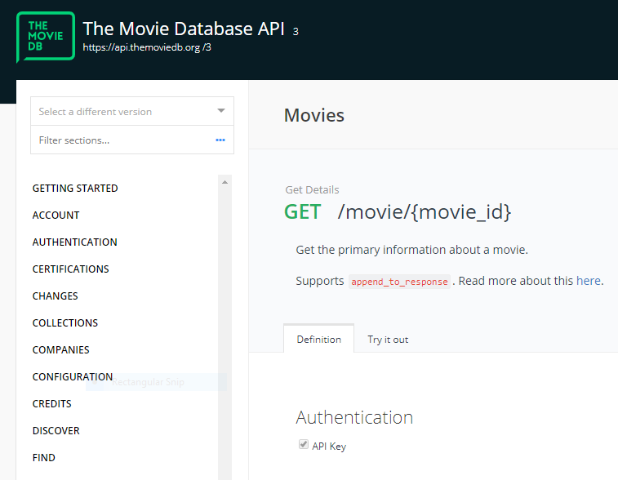
Fetching Data
Movies were fetched using The Movie DB API (TMDB)
Shows were fetched using TVMaze API

Slide 4
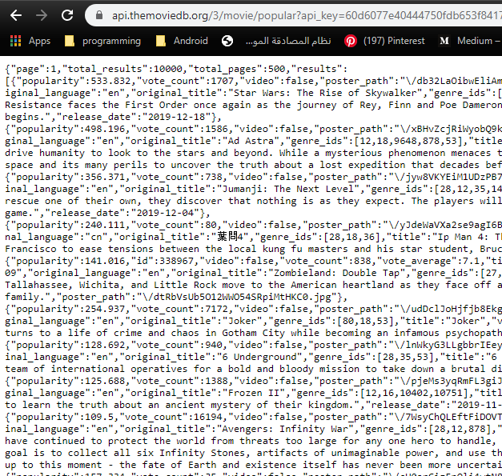
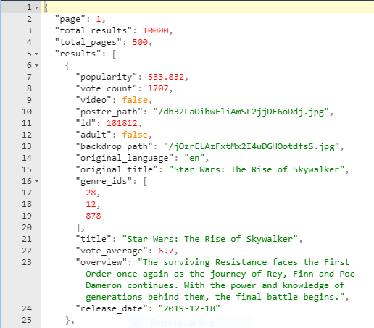
API Response Data
Formatted Data

Slide 5
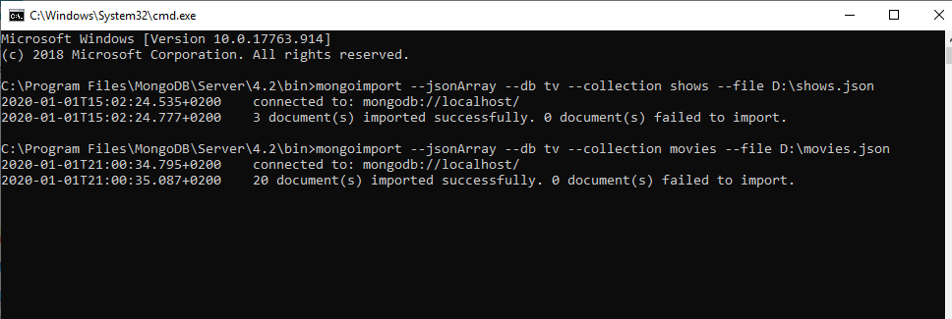
Importing Datasets into MongoDB

Slide 6
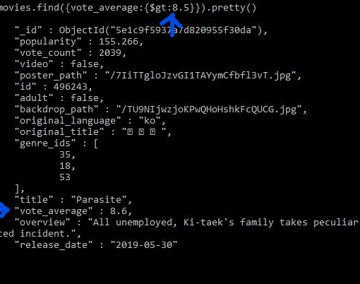
Database Queries
1- Selection:
db.mycol.find();
db.mycol.find().pretty();
db.mycol.find({“key":“value/condition"}).pretty();

Slide 7
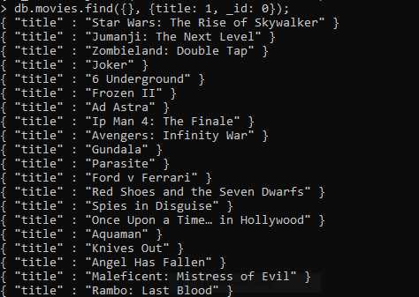
2- Projection:
db.COLLECTION_NAME.find({}, {KEY1: 1, KEY2: 1})
KEY: 1 -> Show KEY
KEY: 0 -> Hide KEY

Slide 8
